Slide 1
The Powertip PG 12864-N
Liquid Crystal Display
WD Henderson
October, 2007

Slide 2
Introduction
The Powertip PG 12864-N is a monochrome LCD device:
  Uses the Sharp LH155BA controller
  Serial or parallel interface
  128 x 64 bit graphics display
  No internal character table!
  Backlit – green
  Power and logic supply of 1.8 to 5.5V
  Consumes 3mA max
  Backlight power= 40mA (typical)

Slide 3
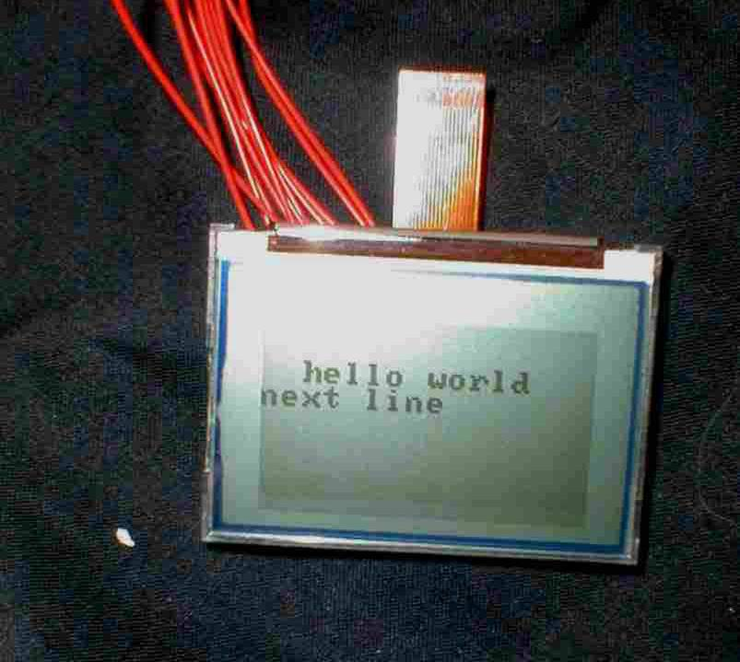
The Powertip PG12864-N LCD device

Slide 4
Internal Logic
DB7
…
DB0
Vss
RES
CS
RS
P/S
W/R
RD
Vdd
SCL
SDA
K
A
LCD Panel
LCD Controller
Sharp LH155BA
Backlight

Slide 5
ARM7 Interface
P16
P17
P18
P19
P3
P4
DB7
…
DB0
Vss
RES
CS
RS
P/S
W/R
RD
Vdd
SCL
SDA
ARM7
LCD Controller
Sharp LH155BA

Slide 6
The Interface
The Powertip device offers both serial and parallel interfaces for communicating commands and data
We are using the serial interface to the ARM7 target board – lack of sufficient I/O pins on the ARM7
This limits the performance of the display and is write only – cannot read from the LCD to discover which pixels are lit

Slide 7
Interface Signals
Signal is Changing State
Signal is High
Signal is now low
Signal is either High or Low – and is stable
Signal is changing state – is unstable

Slide 8
Serial Interface
These signals are employed
  SCL – serial clock
  SDA – Serial data
  RS – Serial data or command
RS indicates if this byte is a command or data
Low= Data
High= Command
ARM7 outputs these signals
Data latched on rising edge of clock
RS
SDA
d7
d0
SCL

Slide 9
C code to output to the LCD
OutputLow( CS ); /* activate controller chip */
/* CS was deactivated to improve noise imunity */
OutputLow( SCL ); /* Prepare for clock signal cycle */
/* Output appropriate SR signal, high for command and low for data */
if ( type == 1 )
OutputHigh( RS ); /* Command - assert RS */
else
OutputLow( RS ); /* Data - clear RS */
/* Transmit byte from highest bit to lowest bit */
for ( bit= 0x80 ; bit > 0 ; bit = bit >> 1 ) {
OutputLow( SCL );
if ( c & bit )
OutputHigh( SDA ); /* Data bit is high */
else
OutputLow( SDA ); /* Data bit is low */
Delay_us( WDELAY );
OutputHigh( SCL ); /* When SCL goes high, data on PIN SDA
are accepted by controller */
Delay_us( WDELAY );
}

Slide 10
Display Memory
The LCD is operated in serial mode
Cannot read data from the display in this mode
So – must store the state of the display in software
Many LCD devices can be read – from a video RAM

Slide 11
Display memory – an array of unsigned char
/* Maximal screen character coordinate limits */
#define LCD_X_MAX 0x0F
#define LCD_Y_MAX 0x3F
In pg12864.h
In pg12864.c
/*
* Display RAM - arranged in 16 bytes per row and 64 rows
* VRAM[0][0] is positioned top-left and
* VRAM[LCD_X_MAX][LCD_Y_MAX] at bottom-right
* Each VRAM byte contains 8-pixels
*/
static unsigned char VRAM[LCD_X_MAX + 1][LCD_Y_MAX + 1];

Slide 12
Screen Coordinates
Position (0,0)
The HOME position
Drawing area
128x64 pixels
X
Y
Position (127,63)

Slide 13
Updating Display Memory
After every write to the LCD which changes the display, the display memory must be updated
This allows the application to find out what pixels are lit
The next code fragment shows how this is accomplished inside the function
LCD_SetPixel( X, Y )

Slide 14
/*
* LCD_SetPixel( X, Y )
*
* Sets a pixel at a given address
* corresponding to the point [X,Y]
*
* X in {0..( LCD_X_MAX * 8 ) + 7}
* Y in {0..LCD_Y_MAX}
*
* Sets the pixel in VRAM and then writes the byte containing that pixel
* to the LCD
*
* If the pixel address is out of range, the function does nothing
*
*/
void LCD_SetPixel( unsigned char x, unsigned char y ) {
/* Test coordinates in VRAM address range */
if ( ( x > ( LCD_X_MAX * 8 + 7 ) ) || ( y > LCD_Y_MAX ) )
return;
/* Logical OR this pixel with remaining pixels in this byte */
VRAM[ x / 8 ][ y ] |= 0x80 >> ( x % 8 );
/* Position cursor */
LCD_x_pos( x / 8 );
LCD_y_pos( y );
/* Update the display */
LCD_WriteByte( VRAM[ x / 8 ][ y ], 0 );
}
Modify VRAM
Set pixel on display

Slide 15
The LCD API
The library source pg12864.c implements a number of functions allowing access to the LCD:
void LCD_Init();
void LCD_Home();
void LCD_ClearDisplay();
void LCD_SetPixel( unsigned char x, unsigned char y );
void LCD_ClearPixel( unsigned char x, unsigned char y );
void LCD_PositionCursor( unsigned char x, unsigned char y );
void LCD_PutString( char * string );
void LCD_PutChar( char c );
void LCD_ClearVRAM( void );

Slide 16
LCD_Init(), LCD_Home() and
LCD_ClearDisplay()
void LCD_Init();
  Initialises the LCD – called once prior to any other calls
void LCD_Home();
  Puts the cursor in home position – top-left corner
void LCD_ClearDisplay();
  Clears the entire screen area

Slide 17
LCD_SetPixel() and
LCD_ClearPixel()
void LCD_SetPixel( unsigned char x, unsigned char y );
  Sets the pixel at (x,y)
  x in {0..127}, y in {0..63}
void LCD_ClearPixel( unsigned char x, unsigned char y );
  Clears the pixel at (x,y)
  x in {0..127}, y in {0..63}

Slide 18
LCD_PositionCursor(), LCD_PutString() and
LCD_PutChar().
void LCD_PositionCursor( unsigned char x, unsigned char y );
  Position character cursor – prior to printing a string or character
  x in {0..15}, y in {0..63}
void LCD_PutString( char * string );
  Print a string at current cursor position
void LCD_PutChar( char c );
  Print a character at the current cursor position

Slide 19
Characters and Pixels
Pixels may be set or cleared at any screen address
Character output does not update the VRAM
Characters are rendered in 8x8 pixel font blocks
A character may be displayed at any position on the display (using LCD_PositionCursor)
LCD_PositionCursor takes a column address in {0..15} and a line address in {0..63}
So – a character may be rendered only in character columns but at any vertical address!
The cursor is automatically advanced for successive characters in a string
The carriage return character causes the cursor to advance the beginning of the next line

Slide 20
The Character Font
The file LCDFont.c contains a simple font for the LCD for character codes from 32 to 223
Control codes from 0 to 31 are not rendered (except carriage return= 13)
Codes 223 to 255 are free!
A pixel measures 0.28mm by 0.34mm
Letter “A” = code 65
{ 0x30, 0x78, 0xCC, 0xCC, 0xFC, 0xCC, 0xCC, 0x00 },

Slide 21
Below the 12864 driver
Application
AT91InitialisePIO();
LCD_Init()
LCD_ClearDisplay();
LCD_SetPixel( i, 0 );
pg12864
OutputHigh( CS );
OutputLow( RES );
void OutputLow( unsigned long bit ){
__PIO_CODR = bit;
}
void OutputHigh( unsigned long bit ){
__PIO_SODR = bit;
}
AT91PIO
ARM7
Powertip LCD

Slide 22
Acknowledgements
Informed by published code of Michael Beigl, TecO, University of Karlsruhe

